Slide 1
EIGENVECTORS
AND
EIGENVALUES

Slide 2
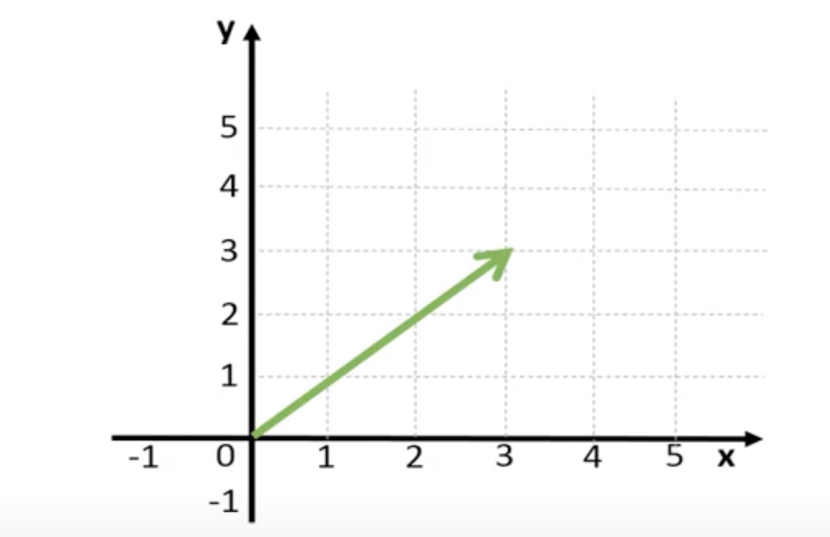
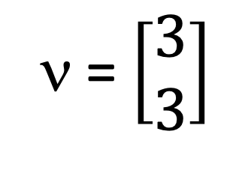
VECTORS
ν = $\left[\begin{aligned}3 \\ 3\end{aligned}\right]$
Notes:
Vector is a matrix with a single row or a single column. Given is a column vector as it has only one column. And this vector can be represented in a two-dimensional plane like this.

Slide 3
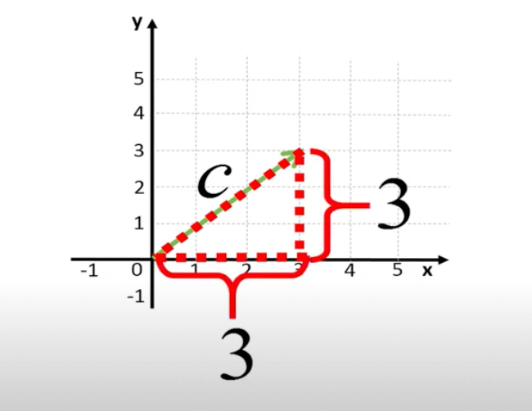
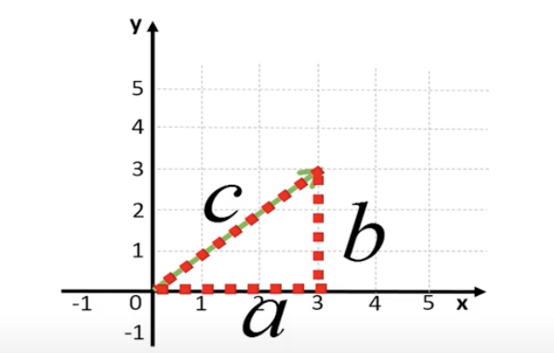
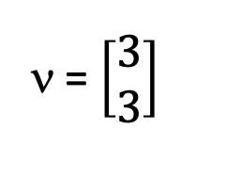
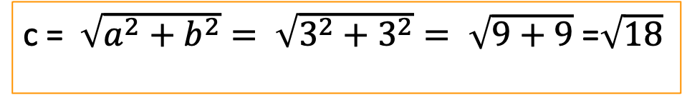
VECTORS
ν = $\left[\begin{aligned}3 \\ 3\end{aligned}\right]$
c = $\sqrt{a^{2}+b^{2}}= \sqrt{3^{2}+3^{2}}= \sqrt{9+9}$ =$\sqrt{18}$
Notes:
The elements of the vector represent the x and y-coordinates. Using Pythagoras’ theorem, the length of the vector can be calculated as shown.

Slide 4
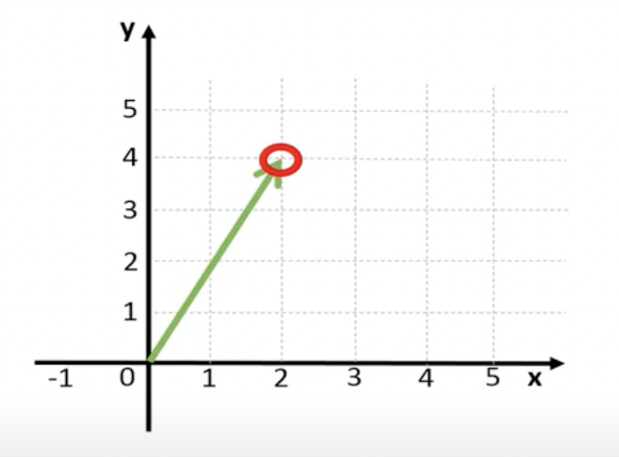
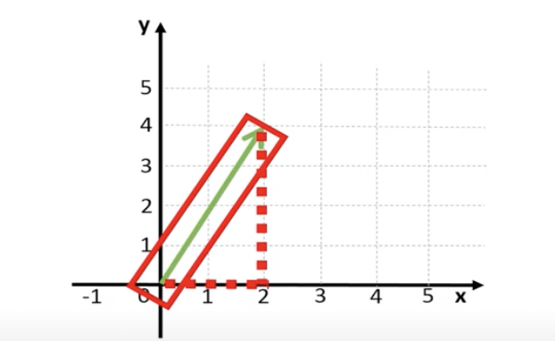
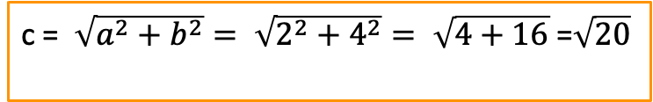
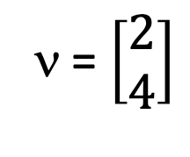
VECTORS
ν = $\left[\begin{aligned}2 \\ 4\end{aligned}\right]$
c = $\sqrt{a^{2}+b^{2}}= \sqrt{2^{2}+4^{2}}= \sqrt{4+16}$ =$\sqrt{20}$
Length of Vector
Notes:
Vectors also have a direction. Consider another vector. This vector can be represented by a line that goes from the origin to the point in space with a x-coordinate of 2, and a y-coordinate of 4.

Slide 5
EIGENVECTORS
An eigenvector (ν) is a non-zero vector that satisfies the following condition:
Aν = λν
If we multiply a vector with matrix A, we get a new vector that does not change direction after the transformation
Notes:
Eigenvector is a special vector. If we multiply a matrix A with a vector ν, and if we get a new vector, that is equal to a number (λ) times the old vector, then ν is an eigenvector. This implies that the new vector does not change direction after the transformation.

Slide 6
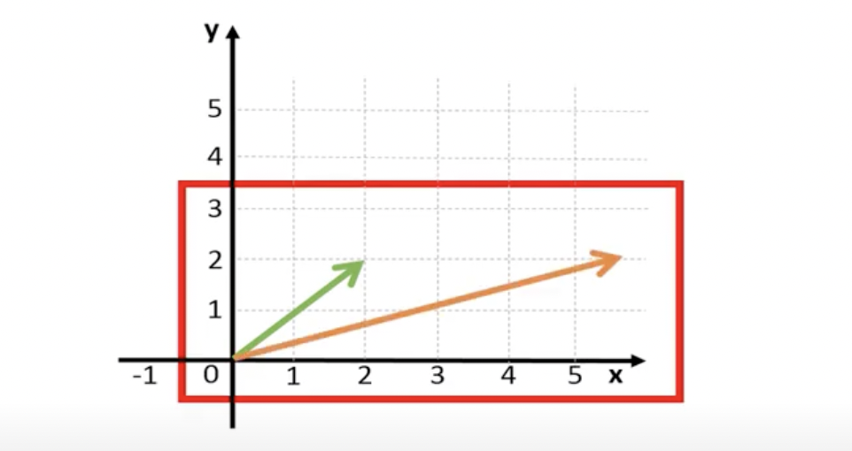
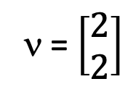
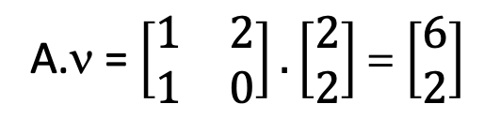
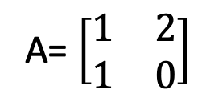
EIGENVECTORS
ν = $\left[\begin{matrix}2 \\ 2\end{matrix}\right]$
A= $\left[\begin{matrix}1 & 2 \\ 1 & 0\end{matrix}\right]$
A.ν = $\left[\begin{matrix}1 & 2 \\ 1 & 0\end{matrix}\right].\left[\begin{matrix}2 \\ 2\end{matrix}\right]$ = $\left[\begin{matrix}6 \\ 2\end{matrix}\right]$
New vector has different direction as the original vector. Thus, vector ν is not an eigenvector of matrix A.
Notes:
Consider ν is the vector of matrix A. And in 2-D plane, it is represented by the green arrow. On multiplying A with ν, we get a new vector, represented by the orange arrow. We observe that the new vector has a different direction. Since the vector changes the direction when multiplied with matrix A, we can conclude that vector ν is not an eigenvector of A.

Slide 7
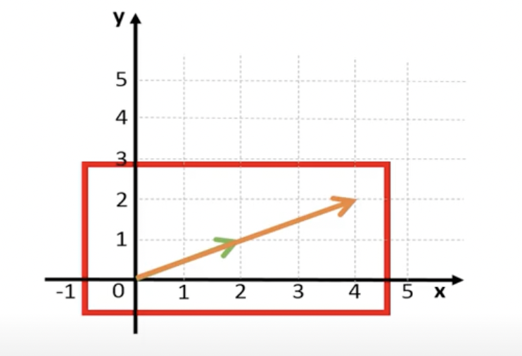
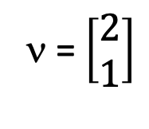
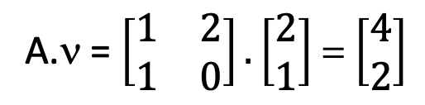
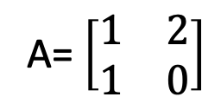
EIGENVECTORS
ν = $\left[\begin{matrix}2 \\ 1\end{matrix}\right]$
A= $\left[\begin{matrix}1 & 2 \\ 1 & 0\end{matrix}\right]$
A.ν = $\left[\begin{matrix}1 & 2 \\ 1 & 0\end{matrix}\right].\left[\begin{matrix}2 \\ 1\end{matrix}\right]$ = $\left[\begin{matrix}4 \\ 2\end{matrix}\right]$
New vector has same direction as the original vector. Thus, vector ν is an eigenvector of matrix A.
Notes:
Consider a new vector. This time the second element in the vector is one instead of two. On multiplying this vector with A, we get a new vector. If we draw this vector in the plane, we see that the new vector has the same direction as the original vector. Therefore, ν is an eigenvector of matrix A.

Slide 8
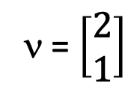
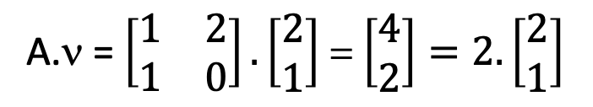
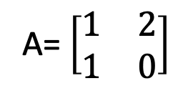
EIGENVALUES
Eigenvalue (λ) tells us how much the eigenvector changes in size when multiplied with the matrix.
ν = $\left[\begin{matrix}2 \\ 1\end{matrix}\right]$
A= $\left[\begin{matrix}1 & 2 \\ 1 & 0\end{matrix}\right]$
A.ν = $\left[\begin{matrix}1 & 2 \\ 1 & 0\end{matrix}\right].\left[\begin{matrix}2 \\ 1\end{matrix}\right]$ = $\left[\begin{matrix}4 \\ 2\end{matrix}\right]=2.\left[\begin{matrix}2 \\ 1\end{matrix}\right]$
A.ν = λ.ν
Thus,
λ = 2
Eigenvalue
Notes:
In our previous example, we get an eigenvector for matrix A. When we multiplied the eigenvector with matrix A, we got a new vector in the same direction as the original vector, and which is twice as long as the original vector. The associated eigenvalue (λ) to the eigenvector is therefore equal to two.

Slide 9
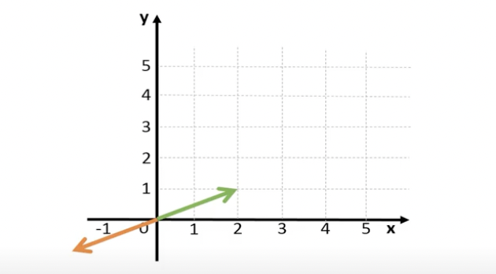
EIGENVALUES
Aν = λν
We can therefore conclude that an eigenvector of a matrix A results into a new vector that has the same directions the original vector but can be longer or shorter than the original vector. This scaling factor is the corresponding eigenvalue.
The eigenvalue can be negative, which means that
the direction of the new vector is reversed but
still on same line.

Slide 10
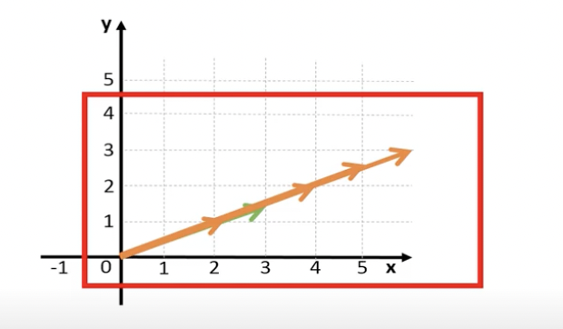
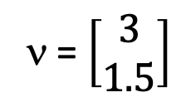
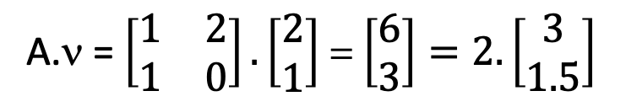
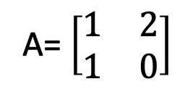
EIGENVECTORS
Consider a new eigenvector (ν) for the same matrix A:
ν = $\left[\begin{matrix}3 \\ 1.5\end{matrix}\right]$
A= $\left[\begin{matrix}1 & 2 \\ 1 & 0\end{matrix}\right]$
A.ν = $\left[\begin{matrix}1 & 2 \\ 1 & 0\end{matrix}\right].\left[\begin{matrix}2 \\ 1\end{matrix}\right]$ = $\left[\begin{matrix}6 \\ 3\end{matrix}\right]=2.\left[\begin{matrix}3 \\ 1.5\end{matrix}\right]$
Again,
λ = 2
Eigenvalue remains same
Notes:
All vectors with the same direction are actually the eigenvectors of matrix A. We found a new eigenvector for matrix A. Although it is a new eigenvector, the corresponding eigenvalue does not change.

Slide 11
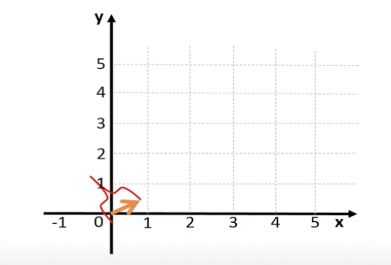
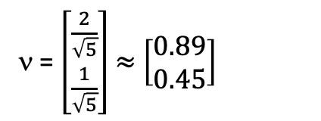



UNIT LENGTH
ν = $\left[\begin{matrix}2 \\ 1\end{matrix}\right]$
$$\sqrt{2^{2}+1^{2}}= \sqrt{5}$$
2² + 1² = 5
$\frac{2^{2}}{5}$ + $\frac{1^{2}}{5}$ =$\frac{5}{5}$
${\left(\frac{2}{\sqrt{5}}\right)}^{2}$+ ${\left(\frac{1}{\sqrt{5}}\right)}^{2}$= 1
Therefore,
Squaring both sides,
Vector of unit length
ν = $\left[\begin{matrix}\frac{2}{\sqrt{5}} \\ \frac{1}{\sqrt{5}}\end{matrix}\right]$ $≈$ $\left[\begin{matrix}0.89 \\ 0.45\end{matrix}\right]$
Software tools report this normalized eigenvector of a matrix with unit length one.
Notes:
Most software tools therefore report normalized eigenvectors to unit length, which means that its length should be equal to one. The current vector has a length that is equal to the square root of five. Dividing both sides by five, gives the right-hand side equals to one. On reformulating, we see that if we let a vector go from the origin to a point with x-coordinate of 2 over the square root of 5, which is about 0.89, and a y-coordinate of 1 over square root of 5, which is about 0.45, the resulting vector has then a length of one.

Slide 12
REFERNECE
https://www.youtube.com/watch?v=N-49t1j-XWY
THANK YOU

